Slide 1
Cell Structure and Membrane Transport

Slide 2
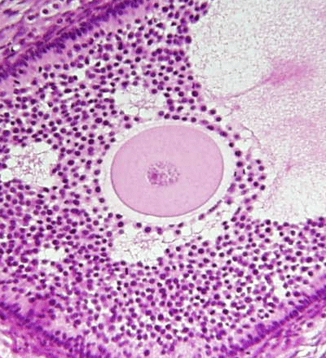
Structures visible under a light microscope
Cell membrane
Nucleus
Cytoplasm

Slide 3
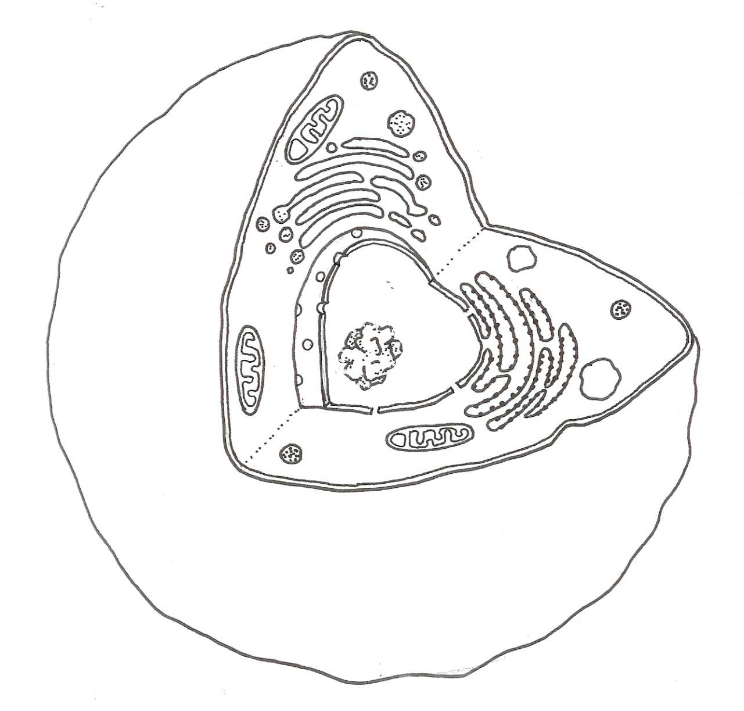
Structure of a Typical Animal Cell
Cell Membrane
Mitochondrion
Golgi Body
Nuclear Membrane
Cytoplasm
Nucleus
Nucleolus
Endoplasmic Reticulum
Lysosome
Notes:
By the start of Unit 2A students should be aware of the structure of a typical animal cell and the functions of the various organelles

Slide 4

Cell (Plasma) membrane
A selectively permeable membrane that controls which substances enter and leave the cell.
Also provides receptor sites for cell-specific chemicals such as hormones.
Cell Membrane

Slide 5

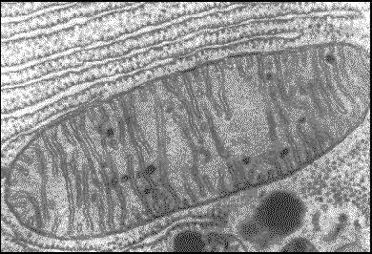
Mitochondrion (pl: mitochondria)
The site of the aerobic phase of cellular respiration
Mitochondrion

Slide 6

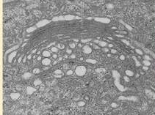
Golgi Body
Responsible for the secretion of cell products such as proteins and lipids.
Forms lysosomes.
Golgi body

Slide 7
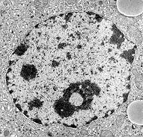
Nucleus (pl: nuclei)
Contains chromosomes whose genes control the activities of the cell. If the nucleus is removed or damaged the cell will die.
Nucleus

Slide 8

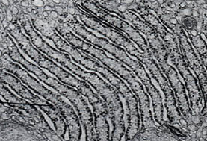
Endoplasmic Reticulum (ER)
Rough endoplasmic reticulum
Rough ER is lined with ribosomes and transports proteins within the cell
Smooth ER is involved in the manufacture of lipids
Ribosomes make proteins

Slide 9
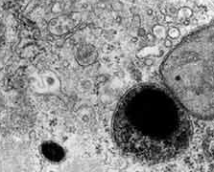
Lysosomes
Membrane-bound vesicles containing digestive enzymes
These enzymes can be secreted or used to destroy ingested material or old cell structures
Can also cause a cell to self-destruct if it is damaged.
Lysosome

Slide 10
Other Organelles
Nucleolus (pl: nucleoli): an organelle inside the nucleus which manufactures and stores RNA
Cytoskeleton: microtubules and microfilaments maintain the cell's shape and also allow cell movement. Microtubule-like structures also occur in cilia, flagellae, centrioles and spindles
Centrioles: form the spindle during cell division

Slide 11
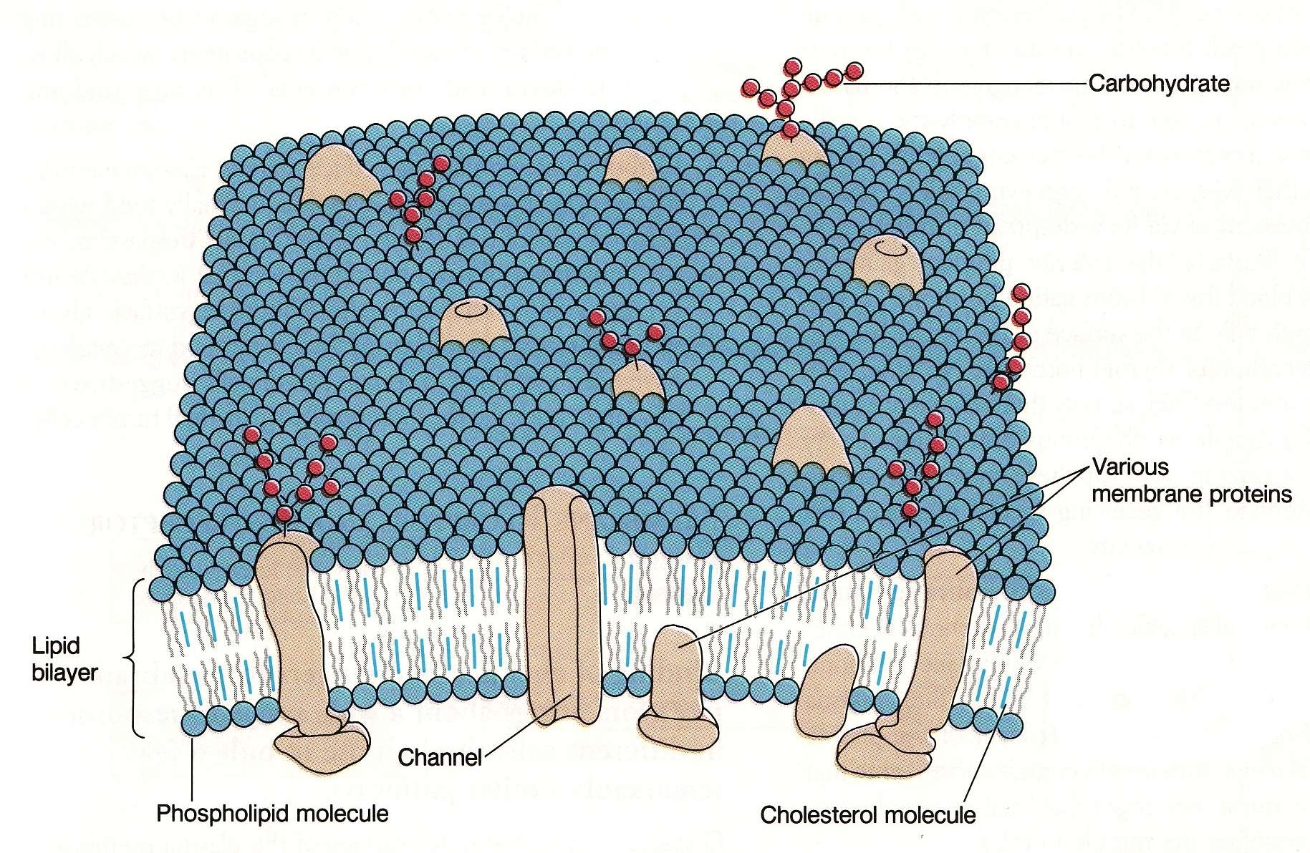
Structure of the Cell Membrane

Slide 12
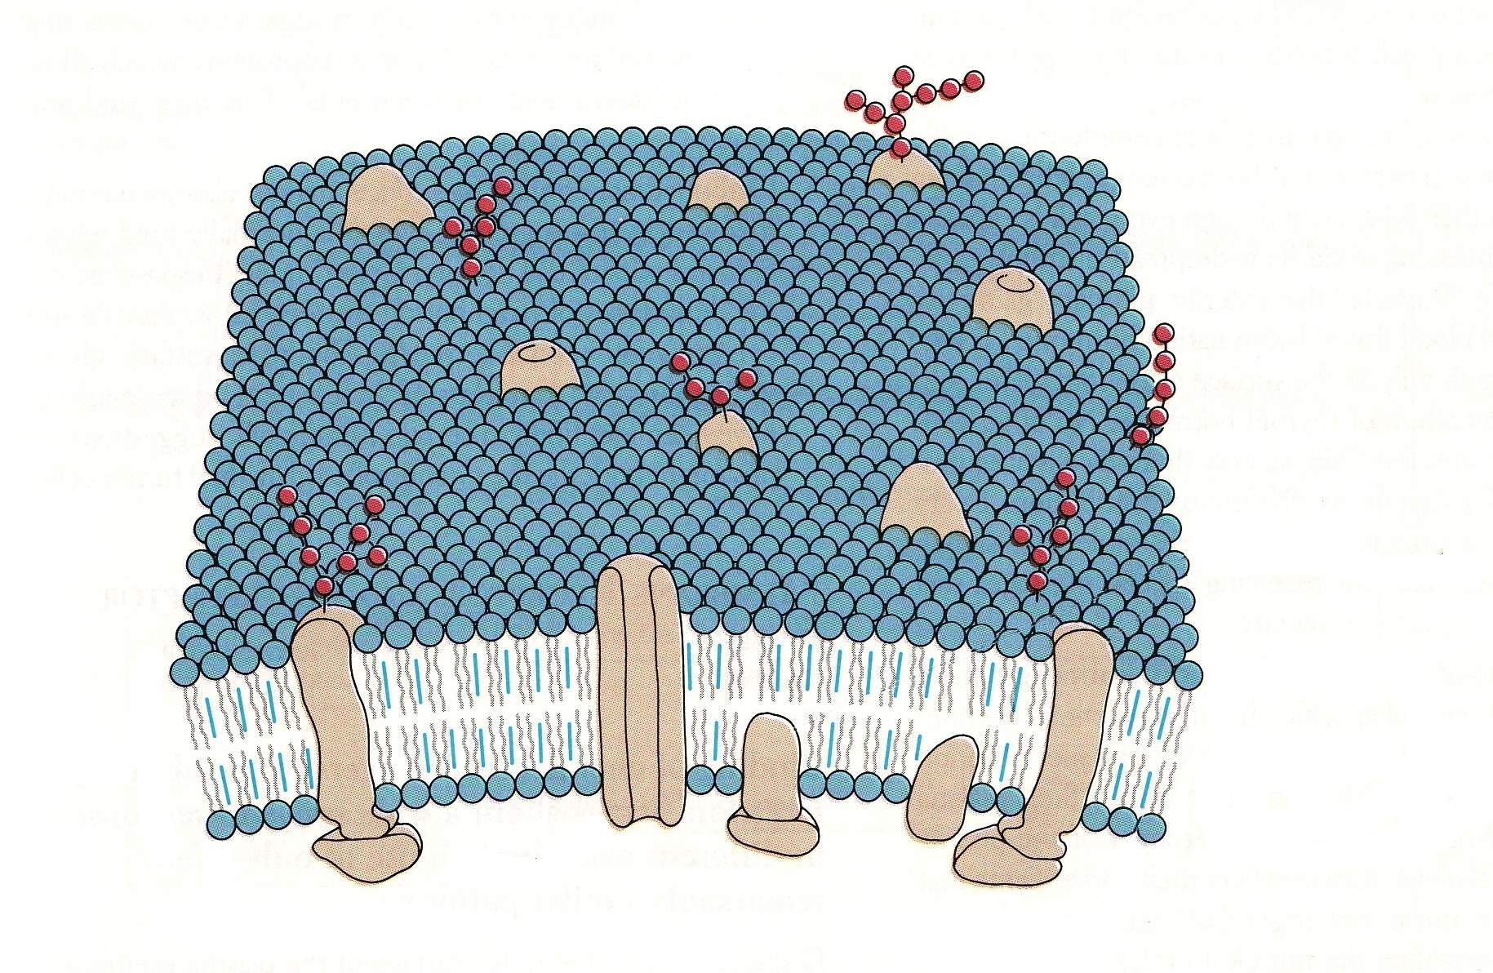
Crossing the Cell Membrane
Some small molecules, like water and ions, diffuse through open protein channels
Oxygen, carbon dioxide and fat soluble molecules diffuse through the phospholipid layers

Slide 13
High concentration
Diffusion gradient
Low
concentration
Rate of diffusion slows
Equilibrium
Uniform concentration

Slide 14
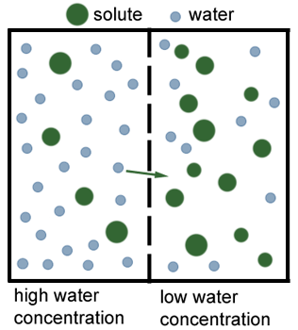
Osmosis
Solute (dissolved substances) cannot move through the membrane
Water molecules can move through the membrane
Examples: reabsorption of water in the kidneys, movement of water from plasma to cells

Slide 15
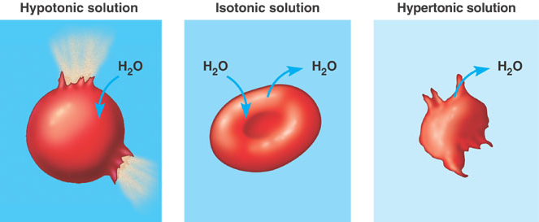
Effects of Osmosis
Hypotonic – solution is less concentrated than in a cell
Isotonic – solution is the same concentration as in a cell
Hypertonic – solution is more concentrated than in a cell

Slide 16
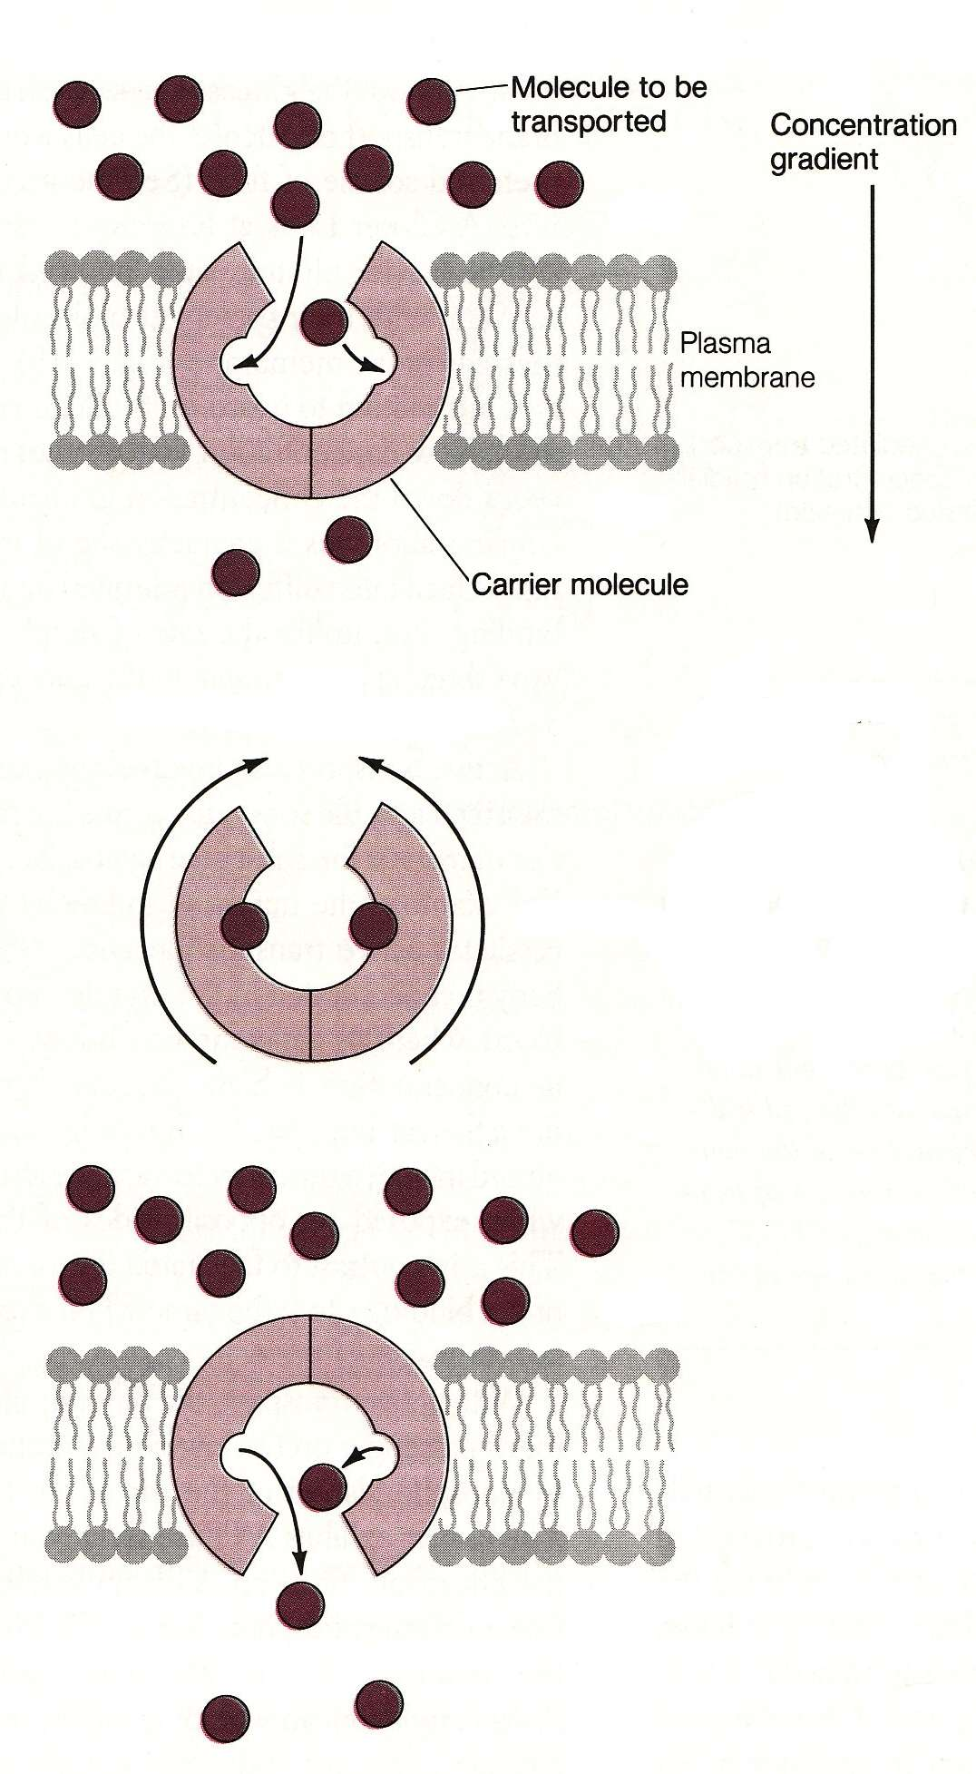
Facilitated Diffusion
No energy required as molecules move with the concentration gradient
Examples: glucose and amino acids

Slide 17
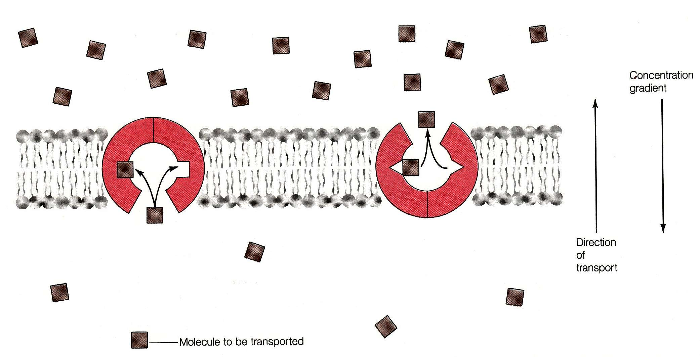
Active Transport
Requires energy to pump against the concentration gradient
Examples: Ions (K⁺, Na⁺, H⁺)
Energy (ATP)

Slide 18
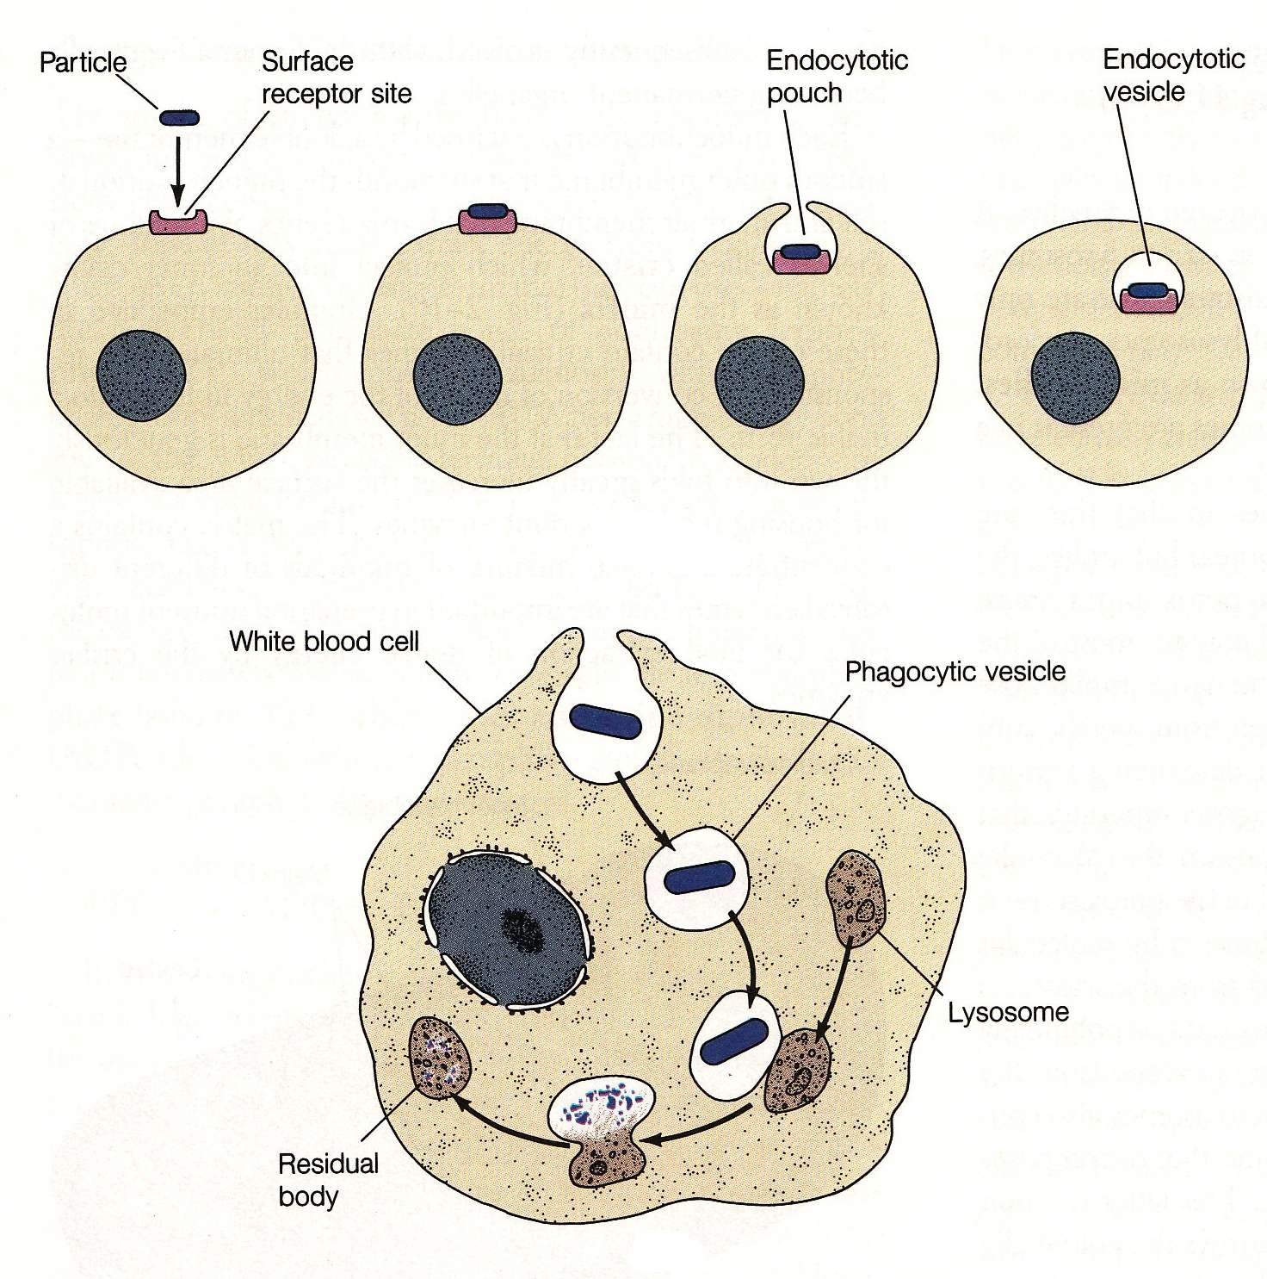
Vesicular Transport
All types require energy
Exocytosis for secretory products, like enzymes and proteins

